Slide 1
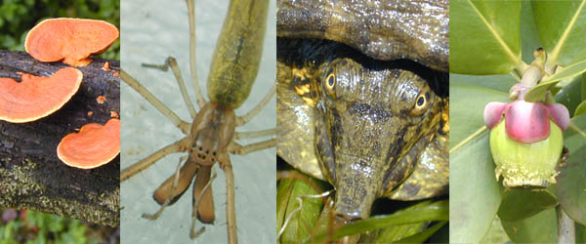
GENERAL BIOLOGY fdn 1203
Dr. Theja Abayarathna
Department of Biology
Faculty of Applied Sciences
Rajarata University of Sri Lanka

Slide 2
Nature and Scope of Biology
Biology is the study of living things
It is the Science of life
It has formed by 2 Greek words
Bios means – life
Logos means - knowledge

Slide 3
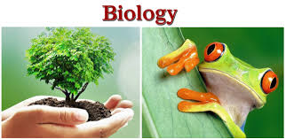
Biology and its branches
Traditionally two branches –Botany and Zoology

Slide 4
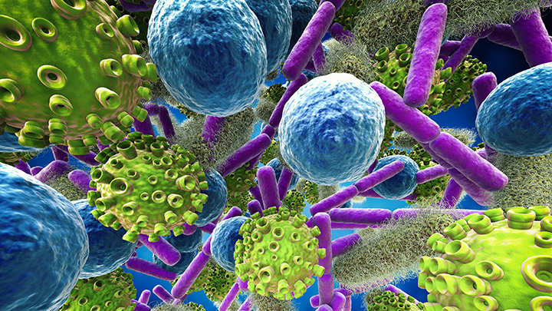
3rd division – Microbiology
Study of microscopic animals not in Zoology and Botany

Slide 5
Biology
Zoology Botany Microbiology
Animals Plants Microscopic
organisms

Slide 6
Subjects studied in various branches of Biology
Physiology – Organ systems
Embryology – Formation of gamates, Events from fertilization of egg to the development of embryo
Ecology – Interaction of plants and animals with the environment.
Taxonomy – Identification, nomenclature and classification of organisms.

Slide 7
Evolution – Continuous adaptations of plants and animals to the environment.
Genetics – Hereditary and variations

Slide 8
Course Capsule
The Nature of Biology:
The branches of Biology, Methods of inquiry in Biology, some basic concepts, Applied Biology.
Biomes to Microhabitats.
Communities and Ecosystems.
Pollution and Conservation.
Systematics: The taxonomic hierarchy, Naming of organisms.
Classification of Organisms: Prokaryota, Monera, Protista, Fungi, Plantae, Animalia.
The Cell as a basic unit: Fine structure of Prokaryotic and Eukaryotic cells.

Slide 9
Tissues, Organs and Individuals: Animal tissues, Plant tissues, Organs and organ systems.
Nutrition: Autotrophic and heterotrophic nutrition, Photosynthesis.
Respiration: Aerobic and anaerobic respiration, BMR.
Transport in animals and plants.
Defense against diseases: Defense systems in animals, Plant defenses against diseases.
Reproduction: Asexual and sexual reproduction.
Principles of Heredity: Monohybrid inheritance, Dihybrid inheritance.
Evolutionary trends.

Slide 10
Assessment Strategy
Mid Semester Exam 40%
End Semester Exam 60%

Slide 11
Thank you!

